Slide 1

Git & GitHub

Slide 2
Definition of Git and GitHub
Git is a distributed version control system that allows multiple people to work on a project simultaneously without overwriting each other's changes. It helps track changes in source code during software development. Think of it as a time machine for your code, where you can go back to any previous version if something goes wrong.
GitHub is a web-based platform that uses Git for version control. It provides a collaborative environment for developers to store, manage, and share their code. Imagine GitHub as a social network for developers, where they can showcase their projects, collaborate with others, and contribute to open-source projects.

Slide 3
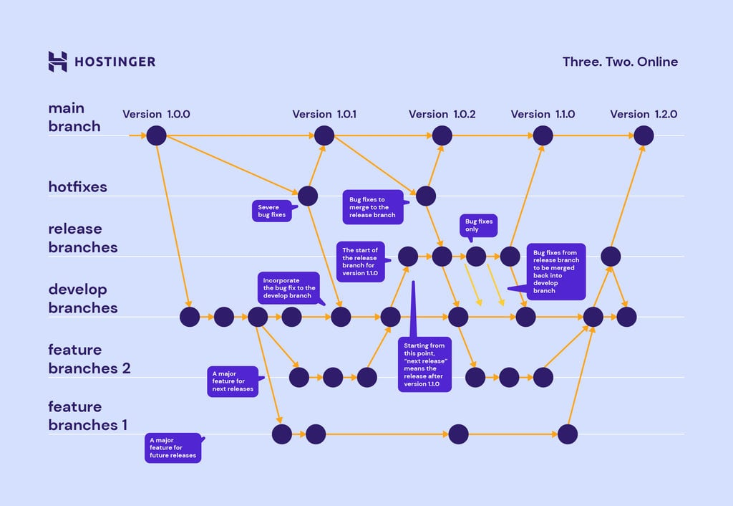
Definition of Git and GitHub

Slide 4
Steps to Set Up a GitHub Account
Setting up a GitHub account is straightforward. Here are the steps:
Visit the GitHub Sign-Up Page:
Go to GitHub's sign-up page.
Enter Your Personal Details:
Username: Choose a unique username.
Email Address: Enter a valid email address.
Password: Create a strong password (at least 15 characters or at least 8 characters with a number and a lowercase letter).
Verify Your Account:
Complete the CAPTCHA to verify that you are human.
Choose Your Plan:
Select the free plan or any other plan that suits your needs.
Complete the Setup:
Follow the on-screen instructions to finish setting up your account.

Slide 5
Steps to Set Up Git Locally
Setting up Git on your local machine involves a few simple steps. Here's a guide to get you started:
Install Git:
Windows: Download the Git installer from git-scm.com and follow the installation instructions.
macOS: Install Git using Homebrew by running brew install git in the Terminal. Alternatively, you can download the installer from git-scm.com.
Linux: Use your package manager to install Git. For example, on Ubuntu, run sudo apt-get install git.
Configure Git:
Open your terminal or command prompt.
Set your username: git config --global user.name "Your Name"
Set your email: git config --global user.email your.email@example.com
Verify the Installation:
Check the installed version of Git by running: git --version

Slide 6
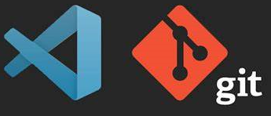
Understanding Git/Vscode Common Commands
1. Clone a Repository:
git clone https://github.com/username/repository.git
2. Change Directory:
cd path\to\your\directory
3. List Files:
ls
4. List Hidden Files:
ls-a
5. Check Git Status:
git status

Slide 7
Understanding Git Workflow
Modify: Edit files in your working directory.
Ranveer and Deepika started spending more time together, adjusting their routines to include each other.
Untracked: New files not yet added to version control.
They explored new activities like road trips and dance classes, enjoying these moments without making them official.
Staged: Files marked to be included in the next commit (git add <file>).
Realizing their strong feelings, they made plans to meet each other's families and discussed future trips, preparing to make their relationship official.
Commit: Save the staged changes to the repository (git commit -m "message").
Finally, Ranveer and Deepika announced their relationship to friends and family, officially becoming a couple.

Slide 8
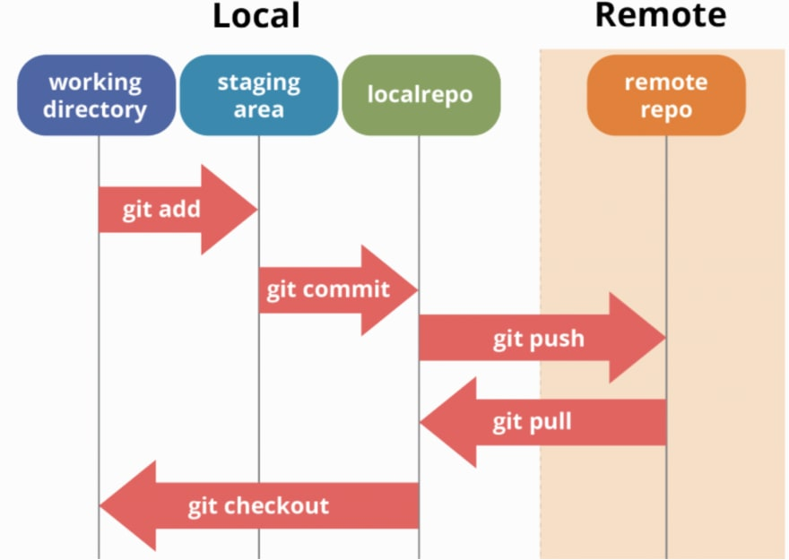
Understanding Git Workflow
Git Push:
Command: git push
Example : git push
Explanation: This command uploads your local commits to the remote repository. It's like sharing your relationship status on social media.
Git Push Origin:
Command: git push origin main
Example : git push origin main
Explanation: This command pushes your commits to the main branch of the remote repository. It's like posting updates on your main social media accounts to ensure everyone sees them.

Slide 9
Essential Git Commands
1. git init
Definition: Initializes a new Git repository.
Usage: git init
Explanation: This command sets up a new Git repository in your current directory. It's like creating a new project folder where you can start tracking changes.
2. git remote add origin
Definition: Adds a remote repository and names it "origin".
Usage: git remote add origin <remote_repository_URL>
Explanation: This command links your local repository to a remote repository (usually on a platform like GitHub). "Origin" is the default name for the remote repository.
3. git remote -v
Definition: Displays the URLs of the remote repositories.
Usage: git remote -v
Explanation: This command shows the URLs of the remote repositories that your local repository is connected to. It's useful for verifying the remote connections.

Slide 10
Essential Git Commands
4. git branch
Definition: Lists all the branches in your repository.
Usage: git branch
Explanation: This command displays all the branches in your repository and highlights the current branch. It's useful for managing and switching between branches.
5. git branch -M
Definition: Renames the current branch.
Usage: git branch -M <new_branch_name>
Explanation: This command renames the current branch to the specified new name. It's useful for standardizing branch names, such as renaming "master" to "main".
6. git push origin main
Definition: Pushes the commits to the "main" branch of the remote repository named "origin".
Usage: git push origin main
Explanation: This command uploads your local commits to the "main" branch of the remote repository named "origin". It's like updating the main version of your project on the remote server.

Slide 11
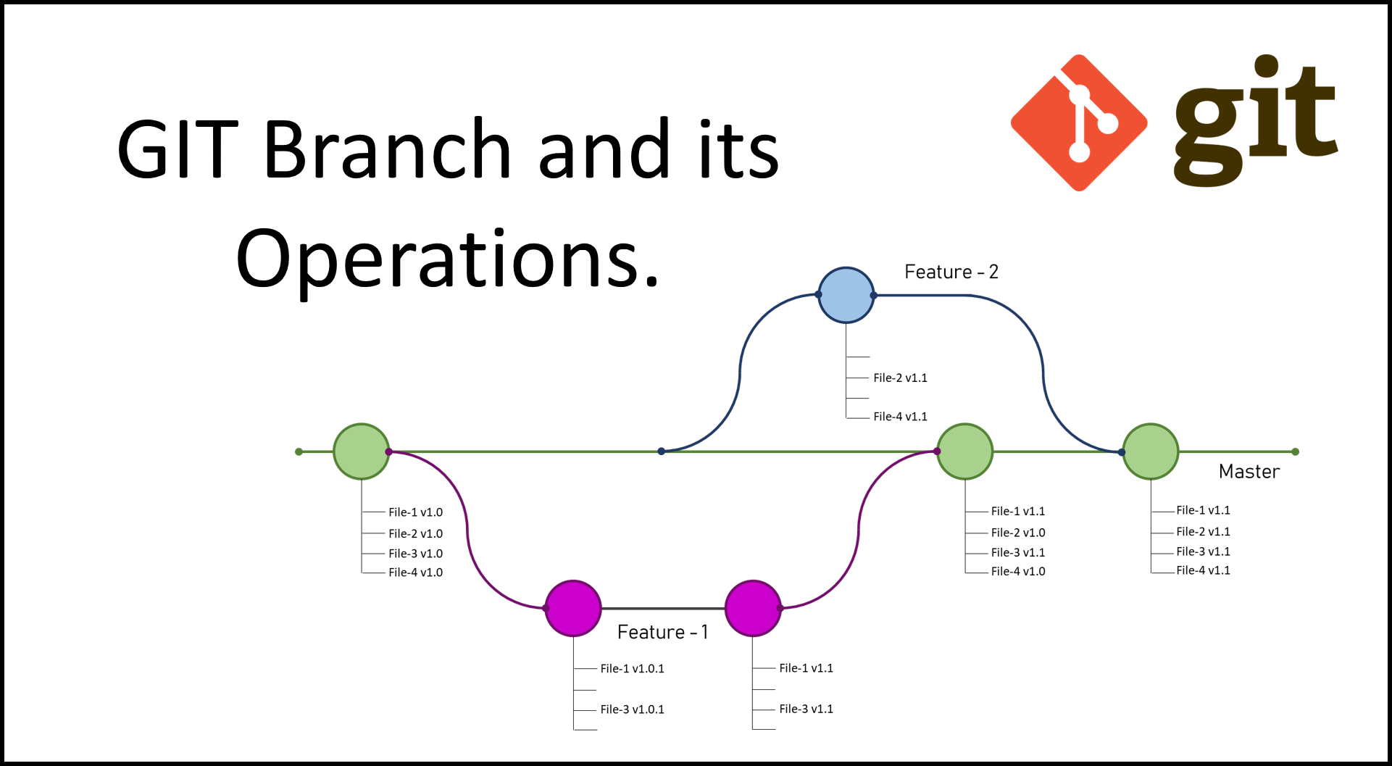
git branch
git branch: Lists all branches.
git branch <branch_name>: Creates a new branch.
git checkout <branch_name>: Switches to a branch.
git checkout -b <branch_name>: Creates and switches to a new branch.
git branch -m <new_branch_name>: Renames the current branch.
git branch -d <branch_name>: Deletes a branch.
git branch -r: Lists remote branches.
git branch -a: Lists all branches.

Slide 12
Merging
1. git diff
Definition: Shows the differences between various commits, branches, or the working directory and the staging area.
Explanation: This command shows the changes that have been made in the working directory but not yet staged. You can also use git diff <branch_name> to compare the current branch with another branch.
2. git merge <branch_name>
Definition: Merges the specified branch into the current branch.
Usage: git checkout main git merge feature-branch
Explanation: This command merges the changes from feature-branch into the main branch. If there are conflicts, Git will prompt you to resolve them.
3. git cherry-pick
Definition: Applies the changes from a specific commit to the current branch.
Usage: git cherry-pick <commit_hash>
Explanation: This command takes the changes from the commit identified by “hash”and applies them to the current branch. It's useful for selectively applying changes.

Slide 13
Merging
4. Pull Request (PR)
Definition: A request to merge changes from one branch into another, typically used in collaborative projects hosted on platforms like GitHub, GitLab, or Bitbucket.
Usage:
Creating a PR:
Push your branch to the remote repository.
Go to the repository on the hosting platform.
Click on "New Pull Request" and select the branches to merge.
Explanation: A PR allows team members to review and discuss changes before merging them into the main branch. It's a key part of collaborative workflows.
5. Merge Conflict
Definition: A merge conflict occurs when Git is unable to automatically resolve differences between two branches.
Usage:
Resolving Conflicts:
Open the conflicting files and manually resolve the conflicts.
Mark the conflicts as resolved:git add <resolved_file>
Complete the merge:git commit
Explanation: When a merge conflict occurs, Git will mark the conflicting areas in the files. You need to manually edit the files to resolve the conflicts, then stage and commit the resolved files.

Slide 14
Undoing Changes in Git
Unstage Changes from staging:
Command: git reset HEAD <file>
Explanation: This command removes the file from the staging area, but keeps the changes in the working directory.
Undo the Last Commit (Discard Changes):
Command: git reset --hard HEAD~1
Explanation: This command undoes the last commit and discards all changes in the working directory.
Revert a Commit:
Command: git revert <commit_hash>
Explanation: This command creates a new commit that undoes the changes from the specified commit.
Discard All Local Changes:
Command: git reset --hard
Explanation: This command discards all local changes and resets the working directory to the state of the latest commit.

